Slide 1
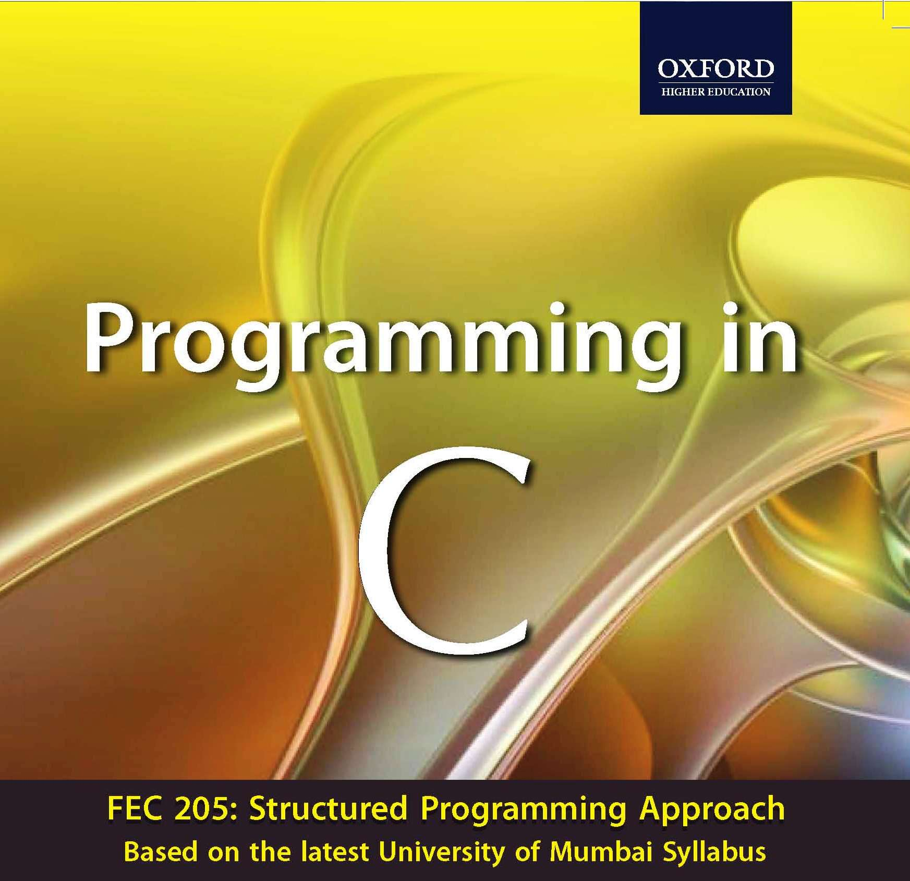


Slide 2
Chapter 2
Basics of C

Slide 3
OBJECTIVE
Understand the basic structure of a program in C .
Learn the commands used in UNIX/LINUX and MS-DOS for
compiling and running a program in C.
Obtain a preliminary idea of the keywords in C.
Learn the data types, variables, constants, operators, and
expressions in C.
Understand and grasp the precedence and associativity rules
of operators in C.
Get acquainted with the rules of type conversions in C.

Slide 4
INTRODUCTION
Ken Thompson at Bell Labs, USA, wrote his own variant over Martin Richards’s Basic Combined Programming Language and called it B .
Dennis Ritchie, at Bell Labs, is credited for designing C in the early 1970s.
Today C is a high-level language which also provides the capabilities that enable the programmers to ‘get in close’ with the hardware and allows them to interact with the computer on a much lower level.

Slide 5
KEY WORDS
ASCII : It is a standard code for representing characters as numbers that is used on most microcomputers, computer terminals, and printers .In addition to printable characters, the ASCII code includes control characters to indicate carriage return, backspace, etc.
Assembler :The assembler creates the object code.
Associativity :The associativity of operators determines the order in which operators of equal precedence are evaluated when they occur in the same expression. Most operators have a left-to-right associativity, but some have right-to-left associativity.

Slide 6
KEY WORDS
Compiler: A system software that translates the source code to assembly code.
Constant :A constant is an entity that doesn’t change.
Data type: The type, or data type, of a variable determines a set of values that the variable might take and a set of operations that can be applied to those values.
Debugger: A debugger is a program that enables you to run another program step-by-step and examine the value of that program’s variables.
Identifier: An identifier is a symbolic name used in a program and defined by the programmer.

Slide 7
KEY WORDS
IDE :An Integrated Development Environment or IDE is an editor which offers a complete environment for writing, developing, modifying, deploying, testing, and debugging the programs.
Identifier: An identifier or name is a sequence of characters invented by the programmer to identify or name a specific object.
Keyword: Keywords are explicitly reserved words that have a strict meaning as individual tokens to the compiler. They cannot be redefined or used in other contexts.

Slide 8
KEY WORDS
Linker: If a source file references library functions or functions defined in other source files, the linker combines these functions to create an executable file.
Precedence :The precedence of operators determines the order in which different operators are evaluated when they occur in the same expression. Operators of higher precedence are applied before operators of lower precedence.
Pre processor :The C pre processor is used to modify the source program before compilation according to the pre processor directives specified.

Slide 9
KEY WORDS
Lvalue: An lvalue is an expression to which a value can be assigned.
Rvalue :An rvalue can be defined as an expression that can be assigned to an lvalue.
Token: A token is one or more symbols understood by the compiler that help it interpret your code.
Word :A word is the natural unit of memory for a given computer design. The word size is the computer’s preferred size for moving units of information around; technically it’s the width of the processor’s registers.

Slide 10
KEY WORDS
Whitespace Space, newline, tab character and comment are collectively known as whitespace.
Variable: A variable is a named memory location. Every variable has a type, which defines the possible values that the variable can take, and an identifier, which is the name by which the variable is referred.
Bug:Any type of error in a program is known as bug. There are three types of errors that may occur:
  Compile errors,
  Linking errors,
  Runtime errors

Slide 11
WHY LEARN C?
There are a large number of programming languages in the world today even so, there are several reasons to learn C, some of which are stated as follows:
a . C is quick.
b . C is a core language : In computing, C is a general purpose, cross-platform, block structured procedural , imperative computer programming language.
c . C is a small language: C has only thirty-two keywords . This makes it relatively easy to learn compared to bulkier languages.
d . C is portable.

Slide 12
DEVELOPING PROGRAMS IN C
There are mainly three steps:
1. Writing the C program
2. Compiling the program and
3. Executing it.
For these steps, some software components are required, namely an operating system, a text editor(integrated development environment), the C compiler, assembler, and linker.
C uses a semicolon as a statement terminator; the semicolon is required as a signal to the compiler to indicate that a statement is complete.
All program instructions, which are also called statements, have to be written in lower case characters.

Slide 13
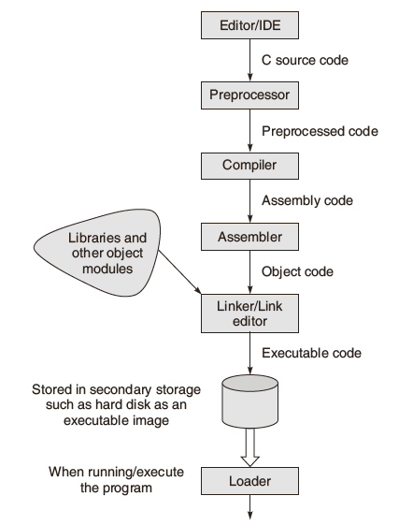
DEVELOPING PROGRAMS IN C

Slide 14
COMPILATION : BORLAND
1. Open MS-DOS prompt.
2. At the prompt c:\windows>give the following command:
c:\windows> cd c:\borland\bcc55\bin Press <Enter>.
This changes the directory to c:\borland\bcc55\bin and the following prompt appears: c:\borland\bcc55\bin>
Now, enter bcc32 -If:\borland\bcc55\include-Lf:\borland\bcc55\Lib c:\cprg\first.c
3. Press <Enter>.

Slide 15
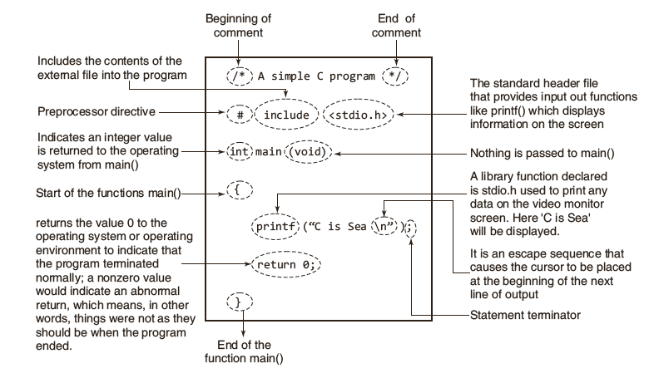
ILLUSTRATED VIRSION OF A PROGRAM

Slide 16
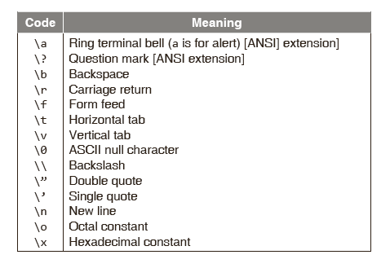
BACKSLASH CODE

Slide 17
PARTS OF C PROGRAMS
Header File
The header files, usually incorporate data types, function declarations and macros, resolves this issue. The file with .h extension is called header file, because it’s usually included at the head of a program.
Every C compiler that conforms to the international standard (ISO/IEC 9899) for the language will have a set of standard header files supplied with it.
The header files primarily contain declarations relating to standard library functions and macros that are available with C.

Slide 18
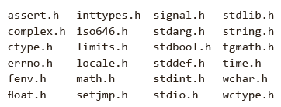
STANDARD HEADER FILES
During compilation, the compilers perform type checking to ensure that the calls to the library and other user-defined functions are correct. This form of checking helps to ensure the semantic correctness of the program.

Slide 19
PHILOSOPHY : MAIN
main() is a user defined function. main() is the first function in the program which gets called when the program executes. The start up code c calls main() function. We can’t change the name of the main() function.
main() is must.
According to ANSI/ISO/IEC 9899:1990 International Standard for C, the function called at program start up is named main. The implementation declares no prototype for this function. It can be defined with no parameters:
int main(void) { /* ... */ }
or with two parameters (referred to here as argc and argv) :
int main(int argc, char *argv[ ]) { /* ... */ }

Slide 20
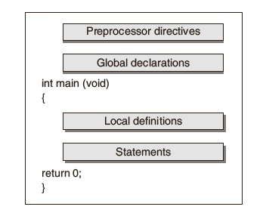
STRUCTURE : C PROGRAM

Slide 21
DECLARATION & DEFINITION
Declaration means describing the type of a data object to the compiler but not allocating any space for it.
  A declaration announces the properties of a data object or a function. If a variable or function is declared and then later make reference to it with data objects that do not match the types in the declaration, the compiler will complain.
  data_type variable_name_1,
Definition means declaration of a data object and also allocating space to hold the data object.
  A definition, on the other hand, actually sets aside storage space (in the case of a data object) or indicates the sequence of statements to be carried out (in the case of a function).

Slide 22
VARIABLES: ATTRIBUTES
All variables have three important attributes:
  A data type that is established when the variable is defined, e.g., integer, real, character. Once defined , the type of a C variable cannot be changed.
  A name of the variable.
  A value that can be changed by assigning a new value to the variable. The kind of values a variable can assume depends on its type. For example, an integer variable can only take integer values, e.g., 2, 100, –12.

Slide 23
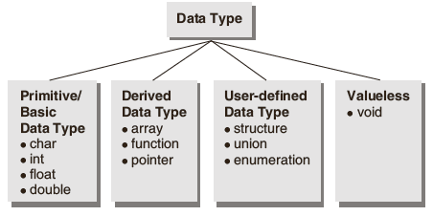

CLASSIFICATION : DATA TYPE

Slide 24
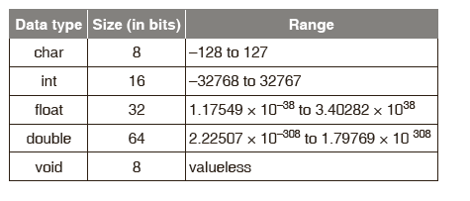
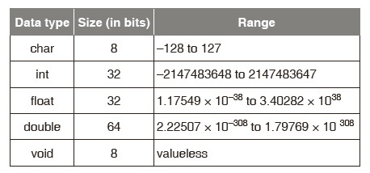
BASIC DATA TYPES:SIZE & RANGE
16 bit computer:
32 bit computer:

Slide 25
SPECIFIER OR MODIFIERS
In addition, C has four type specifiers or modifiers and three type qualifiers.
  Each of these type modifiers can be applied to the base type int.
  The modifiers signed and unsigned can also be applied to the base type char.
  In addition, long can be applied to double.
  When the base type is omitted from a declaration, int is assumed.
  The type void does not have these modifiers.

Slide 26
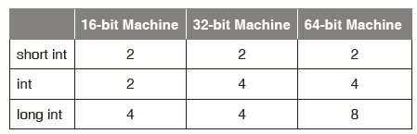
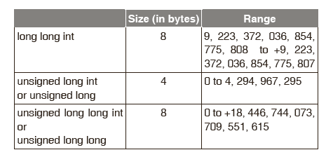
SPECIFIERS : DATA TYPES
The specifiers and qualifiers for the data types can be broadly classified into three types:
  Size specifiers— short and long
  Sign specifiers— signed and unsigned
  Type qualifiers— const, volatile and restrict

Slide 27
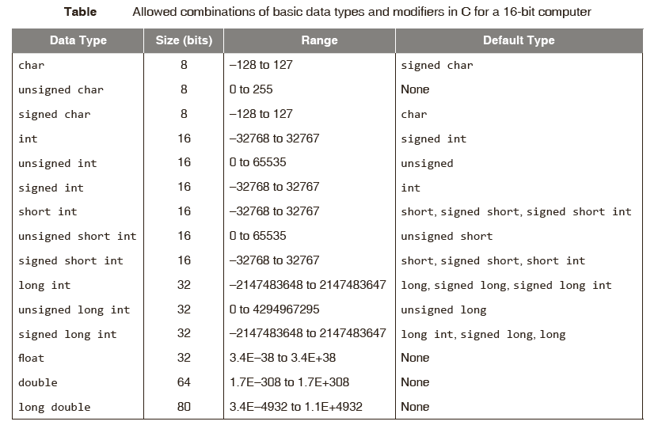

Slide 28
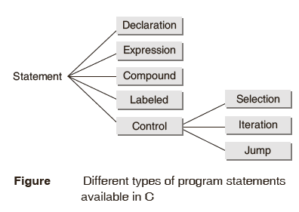
PROGRAM STATEMENTS
A statement is a syntactic constructions that performs an action when a program is executed. All C program statements are terminated with a semi-colon (;).

Slide 29
Cont.
Declaration :It is a program statement that serves to communicate to the language translator information about the name and type of the data objects needed during program execution.
Expression statement: It is the simplest kind of statement which is no more than an expression followed by a semicolon. An expression is a sequence of operators and operands that specifies computation of a value . Example :x = 4
Compound statement is a sequence of statements that may be treated as a single statement in the construction of larger statements.
Labelled statements can be used to mark any statement so that control may be transferred to the statement by switch statement.

Slide 30
Cont.
Control statement is a statement whose execution results in a choice being made as to which of two or more paths should be followed. In other words, the control statements determine the ‘flow of control’ in a program.
  Selection statements allow a program to select a particular execution path from a set of one or more alternatives. Various forms of the if..else statement belong to this category.
  Iteration statements are used to execute a group of one or more statements repeatedly. “while, for, and do..while” statements falls under this group.
  Jump statements cause an unconditional jump to some other place in the program. Goto statement falls in this group

Slide 31
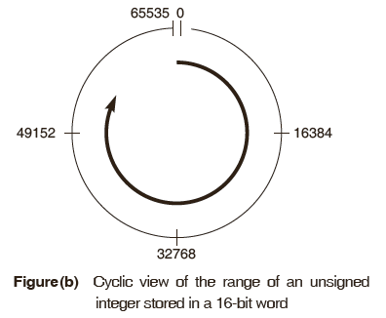
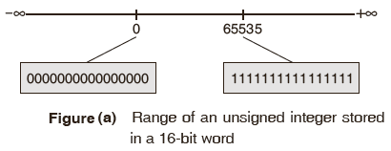
HOW THE INTEGERS ARE STORED IN MEMORY
Storing unsigned integers is a straightforward process . The number is changed to the corresponding binary form & the binary representation is stored.

Slide 32
HOW THE INTEGERS ARE STORED IN MEMORY
For signed integer types, the bits of the object representation shall be divided into three groups: value bits, padding bits, and the sign bit. There need not be any padding bits; there shall be exactly one sign bit (if there are M value bits in the signed type and N in the unsigned type, then M ≤ N). If the sign bit is zero, it shall not affect the resulting value. If the sign bit is one, the value shall be modified in one of the following ways:
  the corresponding value with sign bit 0 is negated(sign and magnitude);
  the sign bit has the value −(2^{N}) (2’s complement);
  the sign bit has the value −(2^{N} − 1) (1’s complement).

Slide 33
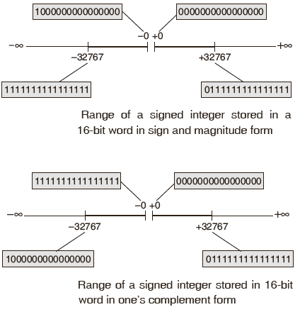
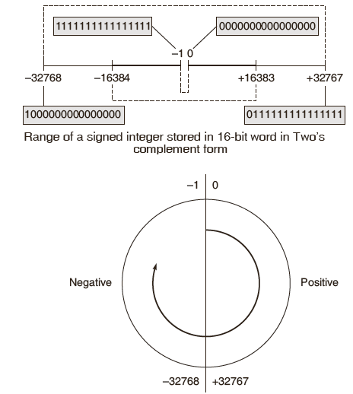

INTEGER STORING:PROCESS

Slide 34
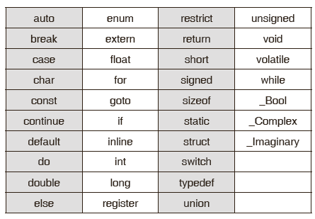
KEY WORDS
Compiler vendors (like Microsoft, Borland ,etc.) provide their own keywords apart from the ones mentioned below. These include extended keywords like near, far, asm, etc.

Slide 35
CONSTANT
A constant is an explicit data value written by the programmer. Thus, it is a value known to the compiler at compiling time.
In ANSI C, a decimal integer constant is treated as an unsigned long if its magnitude exceeds that of the signed long. An octal or hexadecimal integer that exceeds the limit of int is taken to be unsigned; if it exceeds this limit, it is taken to be long; and if it exceeds this limit, it is treated as an unsigned long.
An integer constant is regarded as unsigned if its value is followed by the letter ‘u’ or ‘U’, e.g.,0x9999u; it is regarded as unsigned long if its value is followed by ‘u’ or ‘U’ and ‘l’ or ‘L’, e.g., OxFFFFFFFFul.

Slide 36

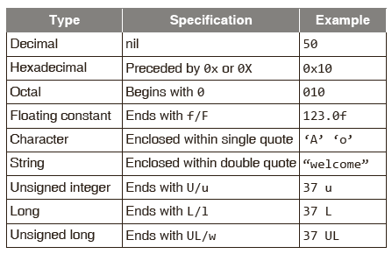
SPECIFICATIONS OF DIFFERENT CONSTANTS

Slide 37
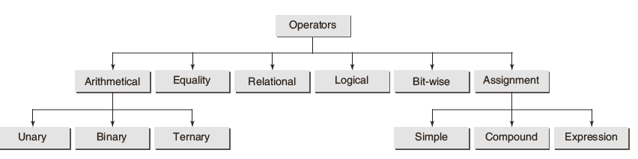
CLASSIFICATION:OPERATORS IN C

Slide 38
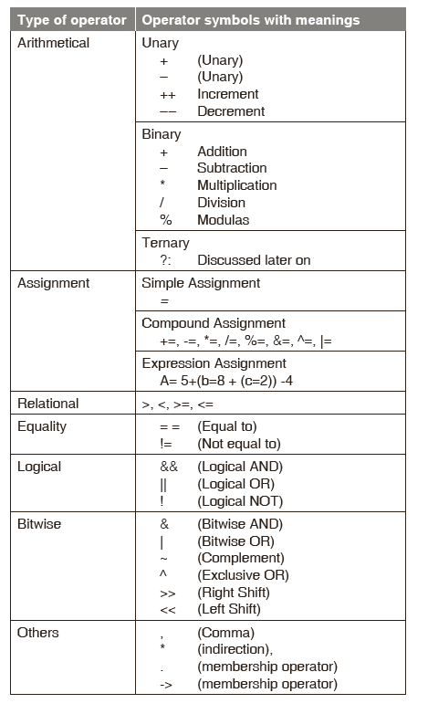
DIFFERENT OPERATORS

Slide 39
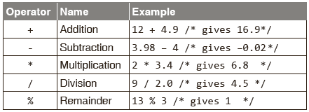
ARITHMETIC OPERATOR
There are three types of arithmetic operators in C:binary,unary, and ternary.
Binary operators: C provides five basic arithmetic binary operators.
  Arithmetic binary operators:

Slide 40
UNARY OPERATION
Unary operators: The unary ‘–’ operator negates the value of its operand (clearly, a signed number). A numeric constant is assumed positive unless it is preceded by the negative operator. That is, there is no unary ‘+’. It is implicit. Remember that -x does not change the value of x at the location where it permanently resides in memory.
Unary increment and decrement operators ‘++’ and ‘--’ operators increment or decrement the value in a variable by 1.
Basic rules for using ++ and – – operators:
  The operand must be a variable but not a constant or an expression.
  The operator ++ and -- may precede or succeed the operand.

Slide 41
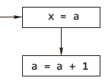
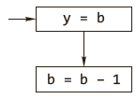
POSTFIX
Postfix:
(a) x = a++;
  First action: store value of a in memory location for variable x.
  Second action: increment value of a by 1 and store result in memory location for variable a.
(b) y = b––;
  First action: put value of b in memory location for variable y.
  Second action: decrement value of b by 1 and put result in memory location for variable b.

Slide 42
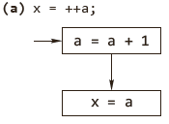
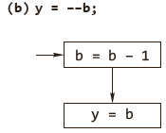
PREFIX
Prefix :
(a) x = ++a;
  First action: increment value of a by 1 and store result in memory location for variable a.
  Second action: store value of a in memory location for variable x.
(b) y = ––b;
  First action: decrement value of b by 1 and put result in memory location for variable b.
  Second action: put value of b in memory location for variable y.

Slide 43
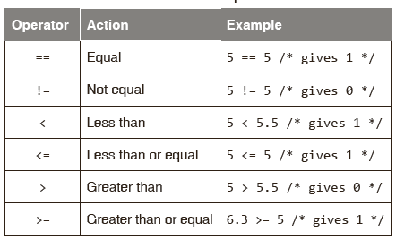
RELATIONAL OPERATORS
C provides six relational operators for comparing numeric quantities. Relational operators evaluate to 1, representing the true outcome, or 0, representing the false outcome.

Slide 44
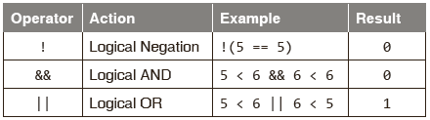
LOGICAL OPERATORS
C provides three logical operators for forming logical expressions. Like the relational operators, logical operators evaluate to 1 or 0.
  Logical negation is a unary operator that negates the logical value of its single operand. If its operand is non-zero, it produces 0, and if it is 0, it produces 1.
  Logical AND produces 0 if one or both its operands evaluate to 0. Otherwise, it produces 1.
  Logical OR produces 0 if both its operands evaluate to 0. Otherwise , it produces 1.

Slide 45
BIT WISE OPERATORS
C provides six bitwise operators for manipulating the individual bits in an integer quantity . Bitwise operators expect their operands to be integer quantities and treat them as bit sequences.
  Bitwise negation is a unary operator that complements the bits in its operands.
  Bitwise AND compares the corresponding bits of its operands and produces a 1 when both bits are 1, and 0 otherwise.
  Bitwise OR compares the corresponding bits of its operands and produces a 0 when both bits are 0, and 1 otherwise.
  Bitwise exclusive or compares the corresponding bits of its operands and produces a 0 when both bits are 1 or both bits are 0, and 1 otherwise.

Slide 46
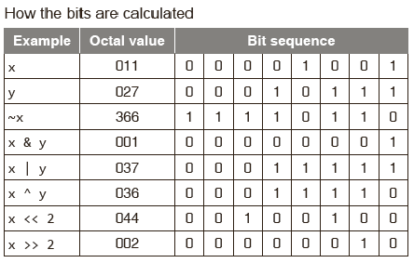
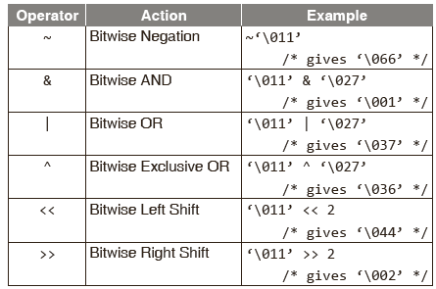
BIT WISE OPERATORS

Slide 47
CONDITIONAL OPERATOR
The conditional operator has three expressions.
  It has the general form expression1 ? expression2 : expression3
  First, expression1 is evaluated; it is treated as a logical condition.
  If the result is non-zero, then expression2 is evaluated and its value is the final result. Otherwise, expression3 is evaluated and its value is the final result.
For example,int m = 1, n = 2, min;
min = (m < n ? m : n); /* min is assigned a value 1 */
In the above example, because m is less than n, m<n expression evaluates to be true, therefore, min is assigned the value m, i.e., 1.

Slide 48
COMMA OPERATOR
This operator allows the evaluation of multiple expressions, separated by the comma, from left to right in order and the evaluated value of the rightmost expression is accepted as the final result. The general form of an expression using a comma operator is
Expression M = (expression1, expression2, …,expression N);
where the expressions are evaluated strictly from left to right and their values discarded, except for the last one, whose type and value determine the result of the overall expression.

Slide 49
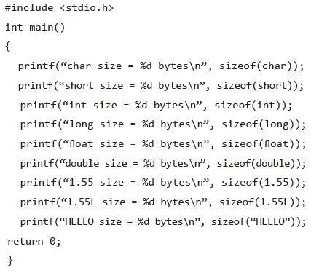
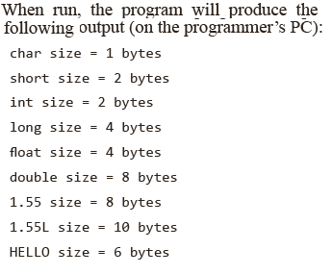
SIZEOF OPERATOR
C provides a useful operator, sizeof, for calculating the size of any data item or type. It takes a single operand that may be a type name (e.g., int) or an expression (e.g.,100) and returns the size of the specified entity in bytes .The outcome is totally machine-dependent.
  For example:

Slide 50
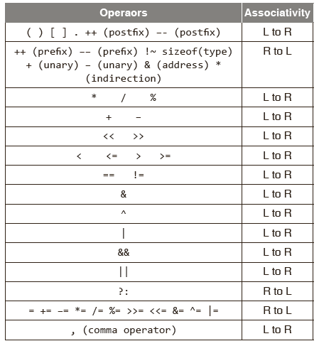
EXPRESSION EVOLUATION: PRECEDENCE & ASSOCIATIVITY
Evaluation of an expression in C is very important to understand. Unfortunately there is no ‘BODMAS’ rule in C language as found in algebra.
The precedence of operators determines the order in which different operators are evaluated when they occur in the same expression. Operators of higher precedence are applied before operators of lower precedence.

Slide 51
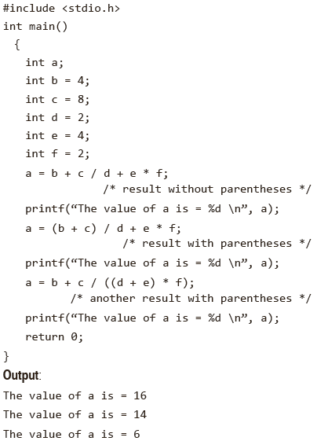
EXAMPLE : OPERATOR PRECEDENCE

Slide 52
LVALUES AND RVALUES
An lvalue is an expression to which a value can be assigned .
An rvalue can be defined as an expression that can be assigned to an lvalue.
The lvalue expression is located on the left side of an assignment statement, whereas an rvalue is located on the right side of an assignment statement.
The address associated with a program variable in C is called its lvalue; the contents of that location are its rvalue, the quantity that is supposed to be the value of the variable.
The rvalue of a variable may change as program execution proceeds; but never its lvalue. The distinction between lvalues and rvalues becomes sharper if one considers the assignment operation with variables a and b.

Slide 53
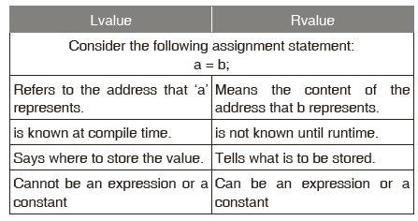
LVALUES AND RVALUES
For example :
  a = b;
  b, on the right-hand side of the assignment operator, is the quantity to be found at the address associated with b, i.e., an rvalue. a is assigned the value stored in the address associated with b. a, on the left-hand side, is the address at which the contents are altered as a result of the assignment. a is an lvalue. The assignment operation deposits b’s rvalue at a’s lvalue.

Slide 54
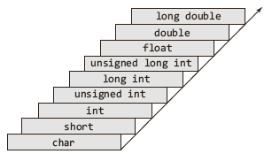
TYPE CONVERSION
Though the C compiler performs automatic type conversions, the programmer should be aware of what is going on so as to understand how C evaluates expressions.
  When a C expression is evaluated, the resulting value has a particular data type. If all the variables in the expression are of the same type, the resulting type is of the same type as well. For example, if x and y are both of int type , the expression x +y is of int type as well.
  The smallest to the largest data types conversion with respect to size is along the arrow as shown below:

Slide 55
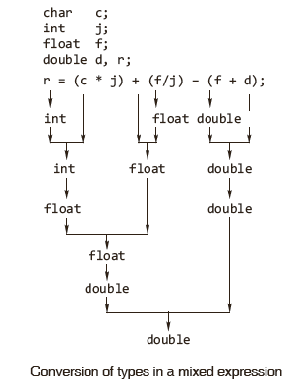
RULE:TYPE CONVERSION
  float operands are converted to double.
  char or short (signed or unsigned) are converted to int (signed or unsigned).
  If any one operand is double, the other operand is also converted to double, and that is the type of the result; or
  If any one operand is long, the other operand is treated as long, and that is the type of the result;
  If any one operand is of type unsigned, the other operand is converted to unsigned, or the only remaining possibility is that Both operands must be int, and that is also the type of the result.

Slide 56
COMPLEX NUMBERS
A complex number is a number with a real part and an imaginary part. It is of the form a + bi where i is the square root of minus one, and a and b are real numbers. a is the real part, and bi is the imaginary part of the complex number. A complex number can also be regarded as an ordered pair of real numbers (a, b).
According to C99, three complex types are supported:
  float complex
  double complex
  long double complex
C99 implementations support three imaginary types also :
  float imaginary
  double imaginary
  long double imaginary

Slide 57
COMPLEX NUMBERS
To use the complex types, the complex.h header file must be included. The complex.h header file defines some macros and several functions that accept complex numbers and return complex numbers.
To use the complex types, the complex.h header file must be included. The complex.h header file defines some macros and several functions that accept complex numbers and return complex numbers. In particular, the macro I represents the square root of –1. It enables to do the following:
  double complex c1 = 3.2 + 2.0 * I;
  fl oat imaginary c2= -5.0 * I;

